Slide 1
LEVELS OF ORGANIZATION
DR. SEEMA JYOTI
ASSOCIATE PROFESSOR
DEPARTMENT OF ZOOLOGY
MANGALDAI COLLEGE

Slide 2
Grade or Level of organization
Depending on the number and degree of specialization present in individuals animal are divided into 5 patterns of organization.
Sub-cellular / Protoplasmic grade of organization:
Cellular grade of organization:
Tissue / Cell-tissue grade of organization:
Organ / Tissue-organ grade of organization:
System / Organ-system grade of organization:
These patterns are approximately in the order in which they have evolved.

Slide 3
1.Acellular /protoplasmic level
Occurs in Protozoa or acellular protists
All activities are performed by one-cell body. However, specialized cytoplasmic structures ,or the organelles, carry on specific functions, thus illustrating division of labour
Colonial protozoans, Ex., Volvox are differentiated into somatic and sex cell. But the somatic cells do not show specialization and division of labour. This distinguishes colonial protozoa from metazoa.

Slide 4
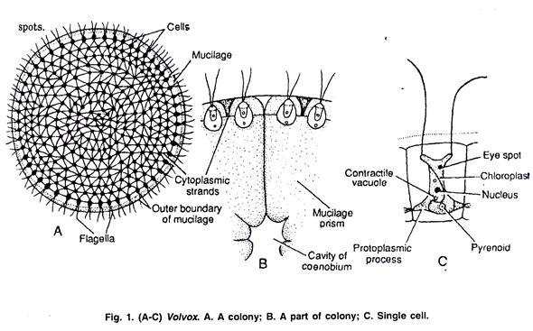
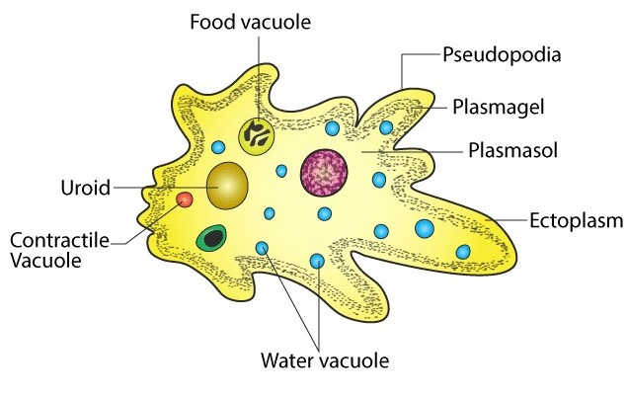
Fig2: Amoeba

Slide 5
2. Cellular level
Multicellular animals such as mesozoans and sponges, are made of loose association of cells. All the cells are in direct contact with the environment, i.e., water which facilitate respiration, excretion and other activities to etc. take place by the general body surface.
Cellular specialization however occurs but cells do not show coordination with each other.
Ex., Germ cells(reproduction) & choanocytes(nutrition).But such cell do not form definite tissue.

Slide 6
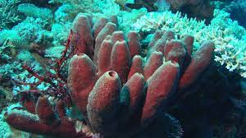
Fig 3: Porifera

Slide 7
3. Cells-tissue level:
Coelenterates are supposed to make the beginning of the tissue plan of the body.
Most of their cells remain scattered at this level, and not organized into tissues. They posses interconnected nerve net of nerve cells with the function of transmission of impulses and coordination.
Thus first truly metazoan phylum of tissue grade organization is Cnidaria or Coelenterata. Their body is generally radially symmetrical and made of only two germ layers, ectoderm and endoderm. Such animals are called diploblastic.

Slide 8
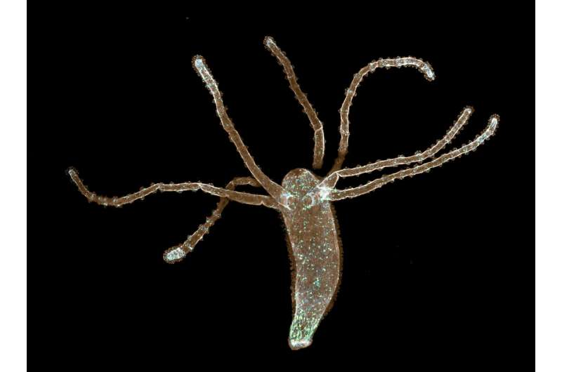
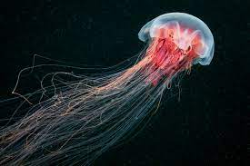
Fig 4: Hydra
Fig 5: Hydra

Slide 9
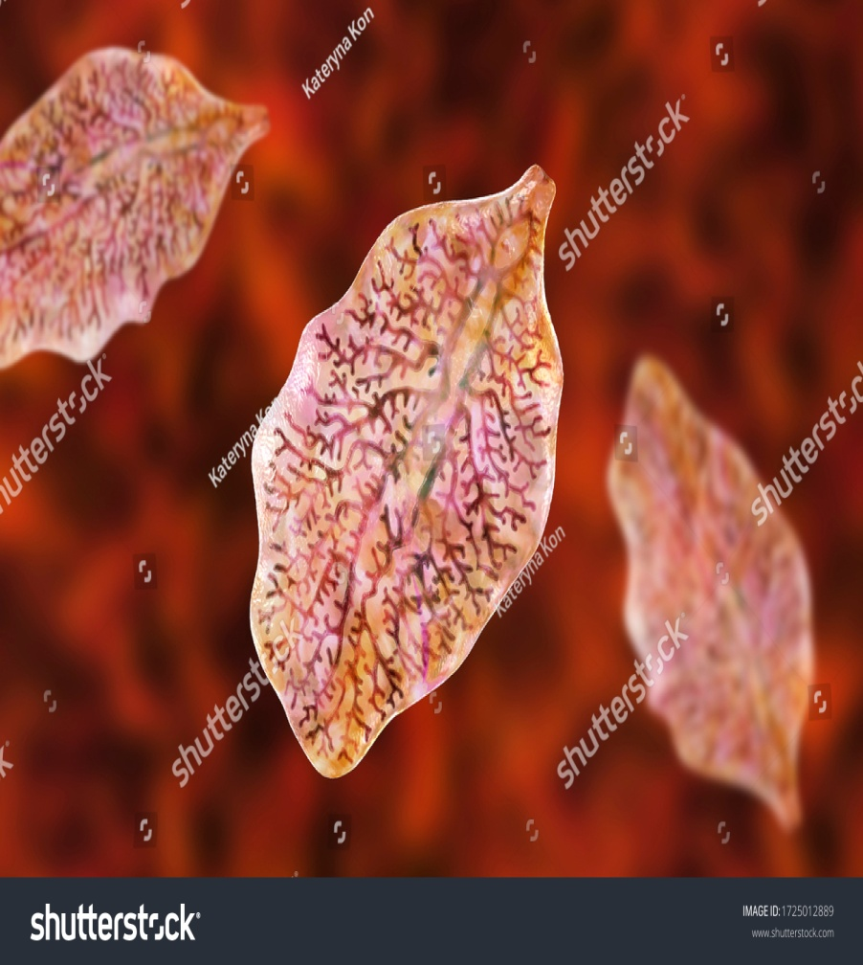
4. Tissue-organ level: Aggregation of tissues into organs with specified function
Platyhelminths are the first bilaterally symmetrical, acoelomate metazoans to have reached the tissue-organ level of organization.
They have a number of well-defined organs such as eyespots, proboscis, gonads etc. They are also triploblastic because they have a third or middle cellular germ layer called mesoderm, which lies between outer ectoderm and inner endoderm.
Fig 6: Liver fluke

Slide 10
5. Organ system level:
In higher animals several organs are associated to form a distinct system concerned with a specific function like digestion, respiration, circulation, excretion and reproduction.
This is the highest level of organization. This is first seen in a group of marine worms known as Nemerteans, Aschelminthes, Annelids and all the other higher phyla show this kind of organization.

Slide 11
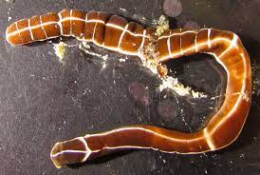
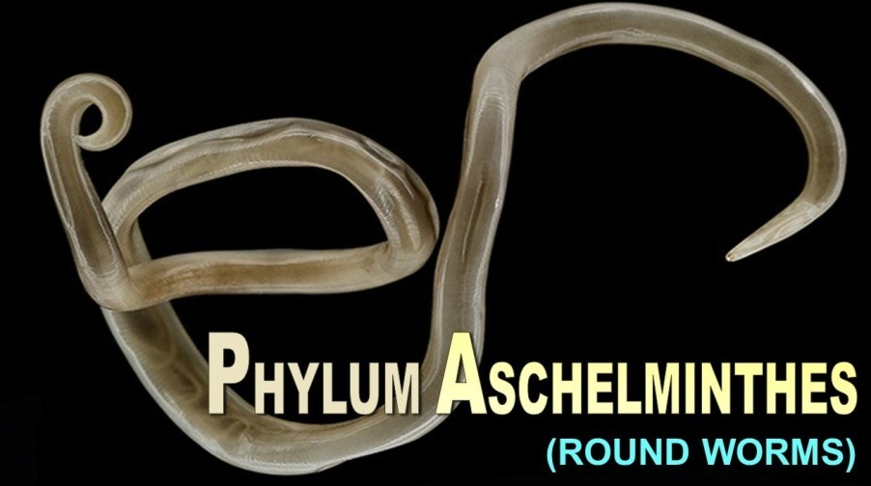
Fig 7: Ribbon worm
Fig 8: Ascaris

Slide 12
THANK YOU

